Slide 1
Cloud Computing and AWS
By Jakub, Viktor, Baratharun, Phillip and Manit
Notes:
Manit

Slide 2
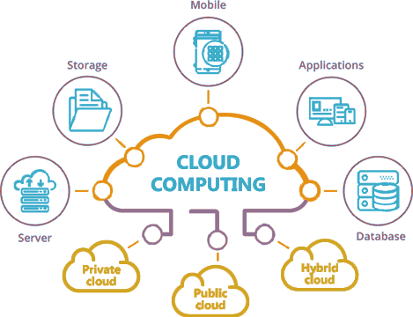
What is Cloud Computing?
The delivery of computing service to offer faster innovation, flexible resources, and economies of scale.
Types of clouds:-
Public Clouds
Private Clouds
Hybrid Clouds
Notes:
Manit
including servers, storage, databases, networking, software, analytics, and intelligence—over the Internet (“the cloud”).
Public Cloud is where company’s use microservices provided by a third party to implement their applications such as AWS, Azure and Google Cloud.
Private Cloud is where companies use their own personal servers to store all the data.
Hybrid Cloud is where you use the best of both worlds. This is especially useful if you have information that you want everyone to see, you can use the public cloud, and if you want to keep all the confidential and sensitive information safe, you use the private cloud. This is often the case when it comes to banks or government websites handling sensitive information.

Slide 3



Who is using it the Industry?
And Many More...
Notes:
Manit

Slide 4
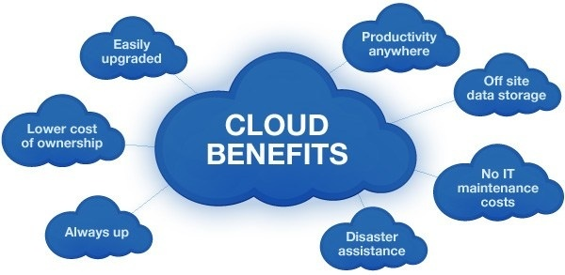
Benefits of Using Cloud Computing?
Reduce IT Costs
Scalability
Collaboration efficiency
Flexibility of work practices
Access to automatic updates
More Reliable and Secure
Notes:
Viktor
Reduce IT Costs: No need to buy expensive equipment, you can use the cloud which reduces the cost of upgrades or energy consumption
Scalability: Business can scale up or down, rather than purchasing upgrades, the cloud can do this for you.
Collaboration efficiency: Cloud computing gives the possibility to communicate and share files more easily outside the traditional methods
Flexibility of work practices: More flexibility thanks to the virtual office which gives you access from many locations
Access to automatic updates: Your software will update to the latest technologies automatically.
More reliable and secure: Data is stored at multiple different cloud locations with strong security measures, making retrieving backup data easy for only those with the correct permissions.

Slide 5
What is AWS? (Amazon Web Services)
AWS is a comprehensive, evolving cloud computing platform provided by Amazon.
It includes a mixture of
infrastructure as a service (IaaS)
platform as a service (PaaS)
software as a service (SaaS)
AWS services can offer an organization tools such as compute power, database storage and content delivery services.
Notes:
Bharat

Slide 6






Who is using it in the Industry?
Active users of AWS exceeds over 1,000,000 people
Many of the biggest companies make use of the service:
Notes:
Jakub

Slide 7
Benefits of using AWS
Go global in minutes
Stop spending money running and maintaining data centers
Increase speed and agility
Stop guessing capacity
pay only for how much you consume
Notes:
Jakub

Slide 8
Summary
Cloud computing allows companies to access comprehensive computing services via the cloud.
These services allows companies to access the large range of benefits that come with the service with only a subscription fee.
AWS is one of the biggest cloud computing services, with many of the largest companies making use of their services.
Notes:
Phillip

